Slide 1
Bank Customer Churn Analysis & Retention Strategy
End-to-End Data Analytics Project using SQL & Power BI
By - Rahul

Slide 2
Objectives
Customer churn directly impacts a bank’s revenue and long-term growth. Understanding why customers leave and which customers are at risk is critical for designing effective retention strategies.
Measure overall and yearly churn
Identify key churn drivers
Segment customers based on behavior and demographics
Provide actionable insights to reduce churn

Slide 3
DATABASE OVERVIEW
The Foundation for Change
CustomerInfo
  Demographics
Age, Gender, Geography)
  Estimated Salary
  Date of Joining
Bank_Churn
  Credit Score,
  Balance, Products
  Activity Status
  Churn Indicator (Exited)
Gender
  GenderID and Gender Category
Active Customer
  ActiveID and Active Category
Credit Card
  CreditID, Category
Exit Customer
  ExitID and Exit Category
Geography
  GeoID and Location

Slide 4
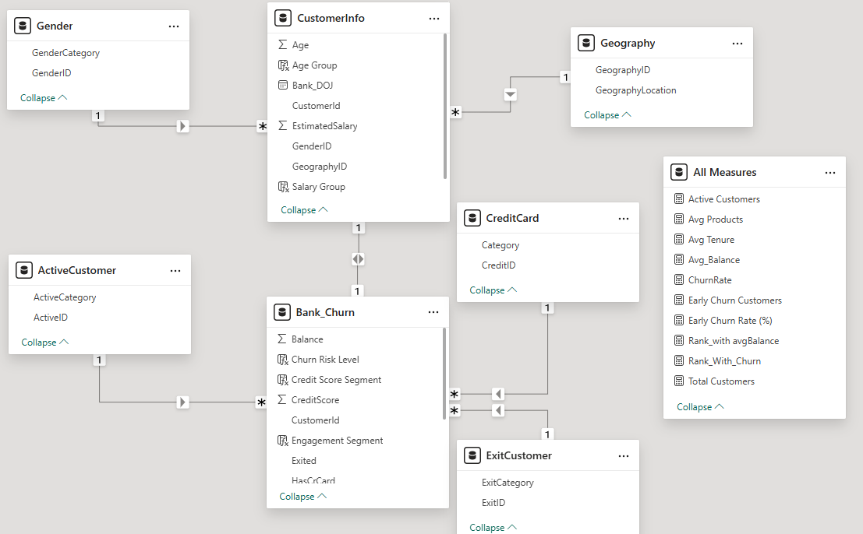
DATABASE OVERVIEW
Database Schema

Slide 5
KEY ENGAGEMENT METRICS
KPIs Monitored
  Total Customers
  Churned Customers
  Churn Rate (%)
  Active Customers
  Average Account Balance
  Average Number of Products

Slide 6
Methodology
How Project is approached
Data Understanding
Data Preparation
Metric Definition
Business Interpretation
Segmentation & Insights
SQL and PowerBI Based Analysis

Slide 7

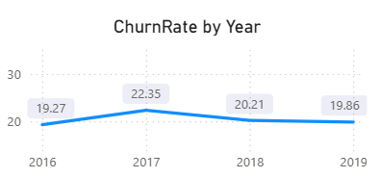
OVERALL & YEAR-WISE CHURN TREND
What we observed
  Churn varies across years
  Certain customer cohorts show significantly higher churn
  Indicates quality of acquisition and engagement varies over time

Slide 8
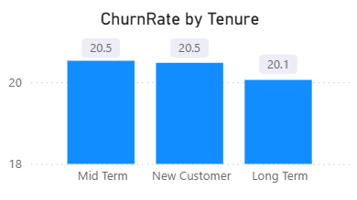
CHURN DRIVER ANALYSIS – TENURE
Short-tenure(0-5 Years) customers churn at a much higher rate
Long-tenure customers show stronger loyalty
Early-stage customer engagement is critical to reduce churn.

Slide 9
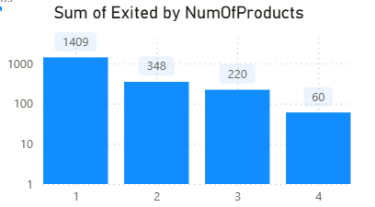
CHURN DRIVER ANALYSIS – PRODUCT USAGE
Customers with 1 product show the highest churn
Churn decreases as the number of products increases
Higher product adoption increases customer dependency and switching cost.

Slide 10
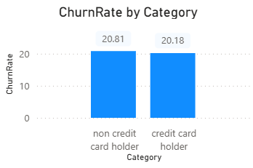
ACTIVITY STATUS & CREDIT CARD IMPACT
Customers with credit cards show lower churn
Credit cards act as an engagement and retention driver
Inactive customers are significantly more likely to churn

Slide 11
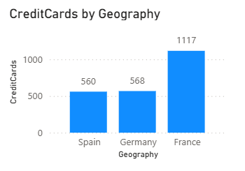
Regional Analysis: Churn & Customer Engagement
Customer behavior and expectations vary by location
Market competition differs across regions
A single retention strategy may not work uniformly
📌 Understanding regional churn helps prioritize targeted interventions.

Slide 12
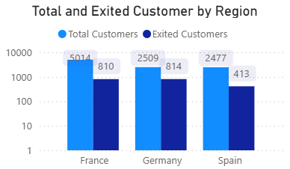
INACTIVE USER RE-ENGAGEMENT
Certain regions exhibit consistently higher churn rates, indicating localized retention challenges.
Regions with a higher share of active customers tend to show lower churn.
Retention efforts should be region-specific, focusing on:
  Improving engagement in high-churn regions
  Promoting credit card adoption where churn risk is high

Slide 13
KEY INSIGHTS SUMMARY
Churn is driven more by engagement than income
Early lifecycle customers are the most vulnerable
Multi-product and active customers are more loyal
Credit card ownership improves retention
Year-wise churn trends highlight acquisition quality issues

Slide 14
BUSINESS RECOMMENDATIONS
  Strengthen onboarding for new customers
  Promote multi-product adoption
  Actively monitor inactive customers
  Expand credit card and reward programs
  Use churn risk dashboards for proactive action

Slide 15
Core Challenges
A significant portion of customers exit within the first few years, indicating gaps in onboarding and early engagement.
Customers with only one banking product show a much higher tendency to churn, reflecting weak customer dependency.
Inactivity is a strong precursor to churn, highlighting the lack of timely re-engagement mechanisms.
Churn rates vary across geographies, suggesting that uniform retention strategies are not effective.
Absence of campaign interaction and transactional behavior data restricts proactive churn prediction.

Slide 16
Summary of Findings
Customers with higher tenure, multiple products, and active status show significantly lower churn rates.
Churn is highest among customers with short tenure, indicating the need for stronger onboarding and early engagement strategies.
Customers holding more than one product are more loyal, while single-product customers are at the highest risk of churn.
Inactivity consistently appears as a leading indicator of customer exit across all segments.
Certain regions exhibit higher churn, suggesting that retention strategies must be tailored geographically.
Customers with credit cards demonstrate lower churn, indicating that credit card benefits and rewards enhance customer stickiness.

Slide 17
CONCLUSION
This project successfully analyzed customer churn behavior using a structured, data-driven approach combining SQL analysis and Power BI visualization.
The analysis revealed that customer engagement factors—such as tenure, activity status, and number of products—play a far more significant role in churn than demographic attributes alone.
Early-stage customers, inactive users, and single-product holders were identified as the most churn-prone segments.
Regional variations in churn highlight the need for localized retention strategies rather than a uniform approach.
Credit card ownership was observed to have a positive impact on customer retention, indicating the importance of value-added services and rewards.

Slide 18
Thankyou

